Slide 1
Getting Started with AWS
Services Overview

Slide 2
AWS’ Rapid Pace of Innovation
AWS has launched a total of 1,599 new features and/or services since inception in 2006.
516
+365*
280
159
82
2011
2012
2013
2014
2015
* As of July 9th, 2015

Slide 3































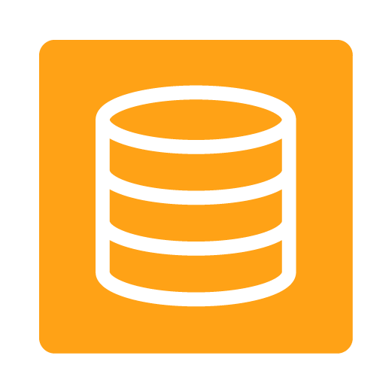



























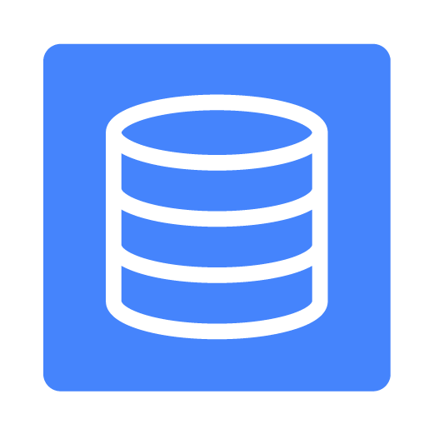


TECHNICAL & BUSINESS SUPPORT
AWS
MARKETPLACE
MANAGEMENT
TOOLS
PLATFORM
SERVICES
ENTERPRISE
APPS
HYBRID CLOUD
MANAGEMENT
Big Data
& HPC
ANALYTICS
MOBILE
DEVELOPMENT
APP
Virtual
Desktops
Direct
Connect
Support
Queuing
Mobile
& Web
Front-end
Data
Warehousing
Sync
Containers
Professional Services
Business Apps
Notifications
Sharing &
Collaboration
Identity
Federation
Hadoop
Identity
Source
Code
Functions
Search
Push
Notifications
Build
Tools
Email &
Calendaring
Deployment
Partner Ecosystem
Security
Streaming
Identity
Orchestration
Data
Pipelines
Mobile
Analytics
Deployment
Data Store
Directories
Backups
Training & Certification
Development
Email
Machine
Learning
Mobile
Backend
DevOps
Real-time
Storage
Gateway
Integrated
Management
Account Management
Backup
SECURITY &
MANAGEMENT
Solutions Architects
Virtual Private
Networks
Identity &
Access
Encryption
Keys
Configuration
Monitoring
Dedicated
Databases
INFRASTRUCTURE
SERVICES
Security & Pricing Reports
Industry
Solutions
Regions
Availability
Zones
Compute
Storage
Objects, Blocks, Files
Databases
SQL, NoSQL, Caching
Networking
CDN

Slide 4
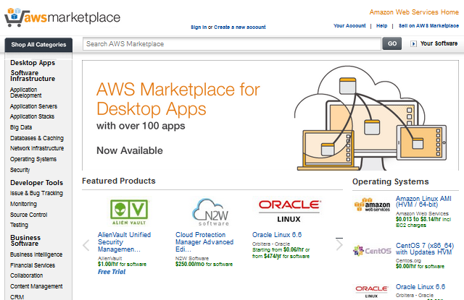
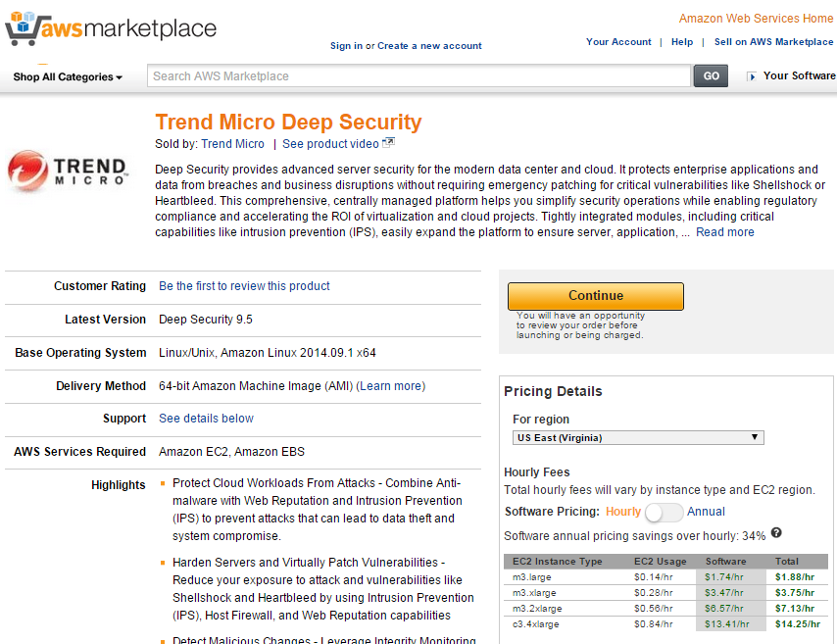
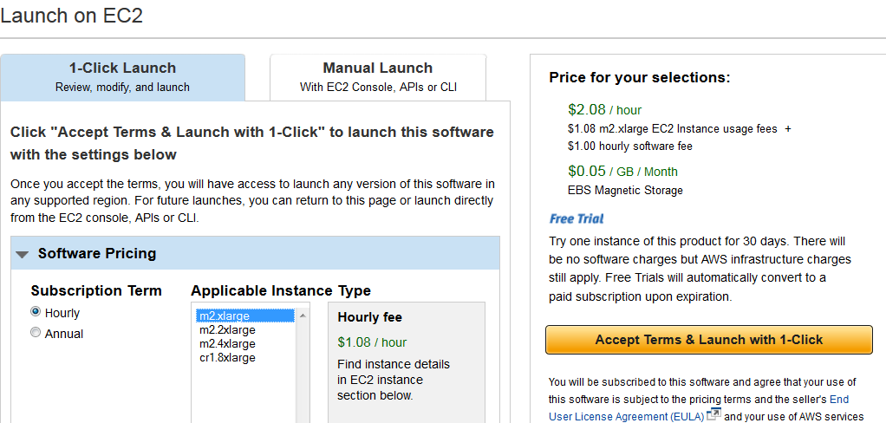
The AWS Marketplace
Broad selection of software configured for AWS
Free trials available for many software products
Flexible pricing: Hourly, monthly, and annual
“1-Click Launch” Deployment
Unified bill including AWS usage and AWS Marketplace software
Multi region deployment – recently expanded to include Germany (FRA)
New software products added weekly

Slide 5



Compute
EC2
Auto Scaling
Lambda
EC2 Container Service

Slide 6
Compute
Elastic Compute Cloud (EC2)
Virtual Servers in the Cloud
Resizable Compute Capacity
Complete control of your computing resources
Reduces time to obtain and boot new server instances to minutes
Choose from 30+ different instance types
Scale as your requirements change
Pay only for what you use

Slide 7
Compute
Auto Scaling
Scale your infrastructure automatically
Adds or removes EC2 instances based on metrics and health checks
No additional charge
Minimize cost and maximize performance
Integrates with Elastic Load Balancers

Slide 8
Compute
Lambda
Run Code in Response to Events
Runs code in response to triggers such as S3 upload, DynamoDB updates, Kinesis streams, and API Gateway requests
Automatically scales
You only need to provide the code; There is no infrastructure to manage
Pay only for what you use

Slide 9
Compute
EC2 Container Service
Run and Manage Docker Containers
A high performance container management service for running Docker containers on EC2 instances
Use the built in scheduler, write your own, or use a third-party scheduler
Integrates with other services like ELB and EBS
No additional charge

Slide 10






Storage & Content Delivery
S3
Storage Gateway
Glacier
Import/Export
EBS
CloudFront

Slide 11
Storage & Content Delivery
Simple Storage Service (S3)
Scalable Storage in the Cloud
Storage for the Internet
Store and retrieve any amount of data, at any time, from anywhere on the web
Highly scalable, reliable, and secure
Supports encryption
Pay only for what you use

Slide 12
Storage & Content Delivery
Glacier
Archive Storage in the Cloud
Low cost storage for archiving and backup
Secure and durable
No limit to amount of data stored
Flexible
Pay only for what you use
Simple integration with S3

Slide 13
Storage & Content Delivery
Elastic Block Store (EBS)
Block Storage for EC2
Persistent off-instance storage
SSD or magnetic disk
Durable snapshots to S3
Encryption support
Provisioned IOPS option

Slide 14
Storage & Content Delivery
Storage Gateway
Integrates On-Premises IT Environments with Cloud Storage
Delivered as a virtual machine installed in an on-premise datacenter
Integration with S3, EBS, and Glacier
Secure data transmissions between AWS and on-premise resources
Compatible with on-premise storage solutions through iSCSI interface.

Slide 15
Storage & Content Delivery
Import/Export
Large Volume Data Transfer
Ship a hard drive to AWS for import or export of data
Supports large data transfers
Data transferred to or from S3 or EBS

Slide 16
Storage & Content Delivery
CloudFront
Global Content Delivery Network
Distribute content with low latency, high transfer speeds, and no commitments
52 edge locations
Simple integration with AWS services
Static and dynamic content
Advanced CDN features like SSL support, geographic restriction, and private content

Slide 17




Database
RDS
DynamoDB
ElastiCache
Redshift
Aurora

Slide 18
Database
Relational Database Service (RDS)
Managed Relational Databases
Resizable capacity
Handles time-consuming administration tasks
Multiple engine types available
High durability options
Automatic patching and backups

Slide 19
Database
DynamoDB
Predictable and Scalable NoSQL Data Store
Fast, fully-managed NoSQL Database Service
Capable of handling any amount of data
Durable and Highly Available
All SSD storage
Simple and Cost Effective

Slide 20
Database
ElastiCache
In-Memory Cache
Managed cache service
Supports Memcached or Redis
Simple resizing through API or console
Integrates with Cloudwatch and SNS

Slide 21
Database
Redshift
Managed Petabyte-Scale Data Warehouse
Fully managed SQL based data warehouse
Less than $1,000/TB/Year
Scale to petabytes without any downtime
Online and functional in minutes
ODBC/JDBC Compliant
Continuous backup

Slide 22
Database
Aurora
Relational Database Engine
Relational database built for the cloud
Highly available, durable, and scalable
Up to 64 TB database size, 15 read replicas
Highly secure
MySQL-compatible

Slide 23




Networking
VPC
ELB
Route 53
Direct Connect

Slide 24
Networking
Virtual Private Cloud (VPC)
Isolated Cloud Resources
Create user defined virtual networks
Allows control of the networking environment
Can be connected to existing datacenters over VPN or Direct Connect
Can be peered with other VPCs in AWS

Slide 25
Networking
Route 53
Scalable DNS and Domain Name Registration
Answers DNS queries with low latency by using a global network of DNS servers
Latency based routing to closest AWS endpoint
Integration with other AWS services
Register domain names

Slide 26
Networking
Elastic Load Balancing (ELB)
Application Load Balancing
Supports load balancing of HTTP, HTTPS and TCP traffic to EC2 instances
Detects and removes failing instances
Dynamically grows and shrinks based on traffic
Integrates with Auto Scaling

Slide 27
Networking
Direct Connect
Dedicated Network Connection to AWS
Establish a dedicated network connection from your premises to AWS
Reduces bandwidth costs for high volume data transfers
Offers consistent network performance
Speeds from 50 Mbps to 10 Gbps per port

Slide 28








Application Services
SES
CloudSearch
SNS
Elastic Transcoder
SQS
Simple Workflow Service
AppStream
API Gateway

Slide 29
Application Services
Simple Email Service (SES)
Email Sending Service
Bulk and transactional email-sending service
Eliminates email server management
Meet rigorous Internet Service Provider (ISP) standards
Built-in feedback loop on successful and unsuccessful messages

Slide 30
Application Services
CloudSearch
Managed Search Service
Integrate fast and highly scalable search functionality into applications
Scales automatically
AWS manages hardware provisioning, data partitioning, and software patches

Slide 31
Application Services
Simple Notification Service (SNS)
Push Notification Service
Set up, operate, and send notifications
Publish messages from an application and immediately deliver them to subscribers or other applications
Push messages to mobile devices

Slide 32
Application Services
Elastic Transcoder
Easy-to-use Scalable Media Transcoder
Converts media files between formats
Highly scalable
Integration with S3 and CloudFront

Slide 33
Application Services
Simple Queue Service (SQS)
Message Queue Service
Managed and scalable message queue
Building block for distributed systems
Highly available and durable
Pay for what you use

Slide 34
Application Services
Simple Workflow Service
Workflow Service for Coordinating Application Components
Coordinate processing steps across distributed systems
Manages workflows, including state, decisions, executions, tasks, and logging
Ensure tasks are executed reliably, in order, and without duplication
Simple API calls can be executed from code written in any language

Slide 35
Application Services
AppStream
Low Latency Application Streaming
Deliver your Windows applications to any device
All the heavy lifting for your application happens in AWS and not the end user’s device
Deploy application and render on AWS. Stream output to mass-market devices
Application scales based on additional compute and storage needs, independent of end user devices
Secure storage of your application

Slide 36
Application Services
API Gateway
Build, Publish and Manage APIs
Performance at any scale via worldwide edge locations, traffic throttling, and API output caching
Monitor API activity
Integrates with Lambda functions
Run multiple versions of the same API
Fully Managed

Slide 37





Administration & Security
Directory Service
CloudWatch
IAM
AWS Config
Trusted Advisor
Service Catalog
CloudTrail
CloudHSM
Key Management Service

Slide 38
Administration & Security
Directory Service
Managed Directories in the Cloud
Enables Single Sign-On and policy management for Amazon EC2 instances and applications.
Compatible with Active Directory
Can be stand alone or integrated with existing directories
Integrates with WorkDocs, IAM, and Workspaces

Slide 39
Administration & Security
Identity and Access Management (IAM)
Access Control and Key Management
Create users, groups, and roles to allow access to AWS
Can be federated with other systems

Slide 40
Administration & Security
Trusted Advisor
AWS Cloud Optimization Expert
Checks your AWS account for cost optimization, performance, fault tolerance, and security
Basic checks are free, all checks unlocked with business level support

Slide 41
Administration & Security
CloudTrail
User Activity and Change Tracking
Records AWS API calls for your accounts
Log files of API calls stored in S3
Enables security analysis, resource change tracking, and compliance auditing
Ability to sent notifications upon log file delivery
Support for many AWS services

Slide 42
Administration & Security
CloudWatch
Resource and Application Monitoring
Visibility into resource utilization, operational performance, and overall demand patterns
Supports custom metrics
Can set alarms that send notifications or trigger Auto Scaling events
Log aggregation with CloudWatch Logs

Slide 43
Administration & Security
AWS Config
Resource Configurations and Inventory
Inventories AWS resources
Notifications on configuration change
Keeps history of configuration changes
Integration with partner solutions

Slide 44
Administration & Security
AWS Service Catalog
Find and Launch Products Using a Personalized Portal
Create and manage catalogs of IT services that are approved for use on AWS
Virtual Machine Images, Servers, Software, Databases, Application Architectures
Manage commonly deployed services, while maintaining compliance and corporate standard requirements

Slide 45
Administration & Security
AWS CloudHSM
Hardware-based Key Storage for Regulatory Compliance
Dedicated Hardware Security Module in the AWS Cloud
You control encryption keys and cryptographic operations
Validated to government standards for secure key management
Synch with your on-premise HSM
Integrates with Redshift, RDS and your own applications

Slide 46
Administration & Security
AWS Key Management Service
Managed Creation and Control of Encryption Keys
Centralized management of your encryption keys
Integrates with AWS services including EBS, S3, RDS, Redshift, Elastic Transcoder, WorkMail, and EMR
Programmatically access your keys from AWS or on-premise
Fully managed

Slide 47





Deployment & Management
Elastic Beanstalk
CodeDeploy
OpsWorks
CodePipeline
CloudFormation
CodeCommit

Slide 48
Deployment & Management
Elastic Beanstalk
AWS Application Container
Ideal for developers that simply want to upload their code and have the service manage the rest
Supports Docker, Java, .NET, Node.js, PHP, Python, and Ruby
Automatically handles deployment, load balancing, auto-scaling, and application health monitoring
Retain full control over the AWS resources powering your application

Slide 49
Deployment & Management
OpsWorks
DevOps Application Management Service
Automate operational tasks like code deployment, software configurations, package installations, database setups, and server scaling
Model the layers of your applications into stacks
Use Chef recipes and cookbooks
Prebuilt templates for PHP, Ruby, Java, Node.js
Granular security control
Use it in AWS or on premises

Slide 50
Deployment & Management
CloudFormation
Templated AWS Resource Creation
Model, provision, and update AWS resources through JSON formatted text files
Deploy stack from template with runtime parameters
Repeatable, reliable provisioning

Slide 51
Deployment & Management
CodeDeploy
Automated Deployments
Automates deployment of software to EC2 instances
Allows for rolling updates and health checks
Platform and language agnostic
Integrates with existing tool chains
Use it on AWS or on premises

Slide 52
Deployment & Management
CodePipeline
Continuous Delivery Service
Automates application deployments and updates for rapid delivery of new features
Model stages of the software release process
Improve code quality through automated builds and tests
Connects to existing tools and systems
Use pre-built or custom plugins

Slide 53
Deployment & Management
CodeCommit
Managed Source Control Service
Eliminates need to scale and operate source control servers
Automatic file encryption
Highly scalable, redundant, and durable
Supports all file types and sizes
Use existing Git tools

Slide 54



Analytics
EMR
Kinesis
Data Pipeline
Machine Learning

Slide 55
Analytics
Elastic MapReduce (EMR)
Managed Hadoop Framework for Big Data Processing
Elastic cluster sizing based on workflow demands
Batch and real-time processing
Long-running or transient clusters
Spot instance support for cost-optimization
Easy integration with AWS datastores

Slide 56
Analytics
Kinesis
Real-time Processing of Streaming Big Data
Fully-managed service for real time processing of streaming data, at any scale
Integrate with S3, Dynamo DB, and Amazon Redshift
Build custom applications on top of Kinesis data

Slide 57
Analytics
Data Pipeline
Orchestration for Data-Driven Workflows
Move data between different AWS data and compute resources
Transform data during transfer
Integrate with on-premise data sources

Slide 58
Analytics
Machine Learning
Build Smart Applications Quickly and Easily
Guided creation of machine learning models
Can pull training data from S3 or RedShift
Supports batch and real-time predictions

Slide 59

Enterprise Applications
WorkSpaces
WorkDocs
WorkMail

Slide 60
Enterprise Applications
Workspaces
Desktops in the Cloud
Create and manage virtual desktops for your users
Integrates with VPC and Directory Service
Clients for Windows, Mac, iPad, Kindle Fire, and Android

Slide 61
Enterprise Applications
WorkDocs
Secure Enterprise Storage and Sharing Services
Store and share documents with others
Review and feedback workflow
Integrates with your corporate directory
Integrates with desktops, laptops, tablets, and Workspaces

Slide 62
Enterprise Applications
WorkMail
Secure Email and Calendaring Service
Managed business email and calendaring service
Enterprise grade security
Outlook compatible
Access from anywhere

Slide 63
Questions?

Slide 64
Thank you!

